Slide 1



“Food Seeker AI Web App Using Python and Flask”
GLOBAL ACADEMY OF TECHNOLOGY
Department of Information Science & Engineering
Mini Project Presentation[21MPT68]
Guided By: Mr. Subhash Kamble
Presented By:
SHIVALINGU K G [1GA21IS150]
VISHWAS S [1GA21IS188]
Notes:
We designed this template so that each member of the project team has a set of slides with its own theme where he/she can present their research. Members, here’s how you add a new slide to just your set:
Mark where you want to add the slide: Select an existing one in the Thumbnails pane, click the New Slide button, then choose a layout.
The new slide gets the same theme as the previous one you selected.
Careful! Don’t annoy your fellow presenters by accidentally changing their themes. That can happen if you choose a theme Variant from the Design tab, which changes all of the slides in your presentation to that look.

Slide 2
Agenda
Overview / Background
Motivation
Objectives
Literature Review
Problem Statement
Project Requirements
System Architecture
Implementation
Expiremental Results
Conclusion
References

Slide 3
Overview / Background
Food Seeker AI Chat is a web application built with Python and Flask. It features an AI
Chatbot that helps users to find and explore food options.
Main Features:
Chatbot Interaction
Restaurant Finder
Recipe Suggestions
User-Friendly Design
DEPARTMENT OF INFORMATION SCIENCE AND ENGINEERING

Slide 4
Motivation
Increase Convenience: Make finding and ordering food easier for users.
Enhance User Engagement: Provide interactive and personalized recommendations.
Leverage AI Technology: Utilize AI to improve user experience and offer smart suggestions.
Support Local Businesses: Help users discover and order from local restaurants.
Simplify Recipe Discovery: Allow users to easily access and explore various recipes.
26-09-2024
DEPARTMENT OF INFORMATION SCIENCE AND ENGINEERING

Slide 5
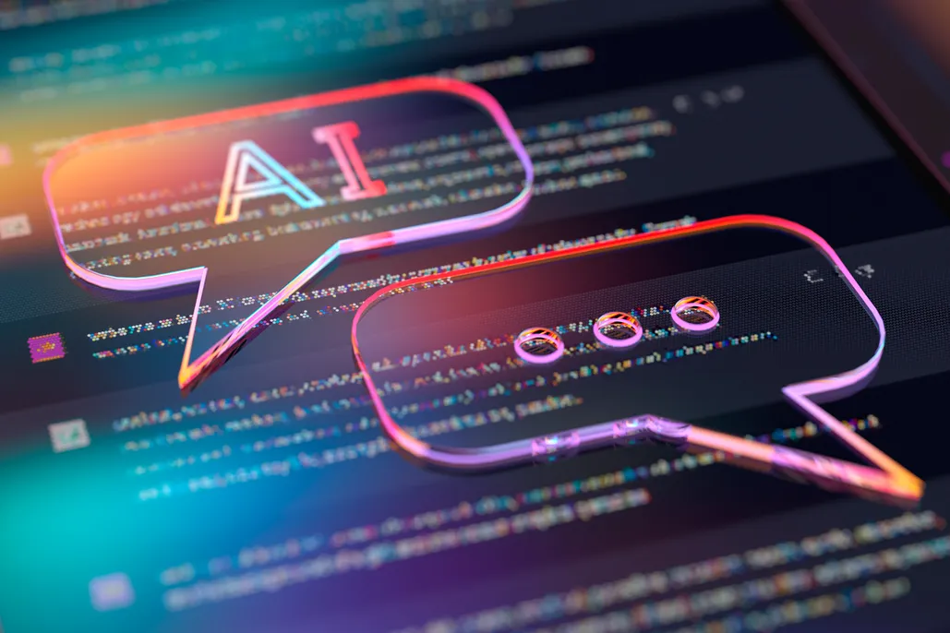
Objectives
Provide instant answers
Recommend Restaurants
Suggest Recipes
Enhance UX
Improve Food Delivery
26-09-2024
DEPARTMENT OF INFORMATION SCIENCE AND ENGINEERING

Slide 6
Literature Review

Slide 7
Literature Review
Author | Title | Journal | Year | Approach | Key Findings
1.Prof.K.Bala etal., | Chat-Bot for College Management System Using A.I. | IRJET | 2017 | AI chatbot to help manage and automate tasks in a college, like answering questions and handling administrative work. | Improved UX , Integration Success,Cost Savings
2.Vineet Singh, etal., | Chat-Bot using Python and Flask | IEEE | 2024 | Setting up a Flask web app to handle user I/P and deploy the app provide responses to user queries. | Better Efficiency , Accuracy,Scalable UX
3.Vinita Kumari etal., | Medical Chat Bot using AI & NLP | i-manager’s Journal on Software Engineering | 2022 | To Understand and respond health queries, Integrate it with a Flask web app for user interaction. | Enhanced Health Care, Data driven Insights, User-friendly Interface
26-09-2024
DEPARTMENT OF INFORMATION SCIENCE AND ENGINEERING

Slide 8
Literature Review
Author | Title | Journal | Year | Approach | Key Findings
4.Carlos Alexander etal., | Apply Natural Language Processing Chatbot on Industry 4.0 | Springer Link | 2023 | It an be used to enhance Industry 4.0 by Improving communication , automating tasks and support decision making . | Enhanced Comm., Increased, Future Potential.
5.Carla-Mihaela BULZESCU , etal., | Chatbot Designed for International Students | Acta Technica Napocensis | 2024 | It examines chatbot can be designed to assist international and support tailored to their needs . | Improved Access to Information, Enhanced support.
26-09-2024
DEPARTMENT OF INFORMATION SCIENCE AND ENGINEERING

Slide 9
Base Paper
Chat-Bot using Python and Flask - IEEE - 2024
26-09-2024
DEPARTMENT OF INFORMATION SCIENCE AND ENGINEERING

Slide 10
Problem Statement

Slide 11
Problem Statement
"Creating a Python and Flask web app with a chatbot for personalized food recommendations,
restaurant searches, and recipe access."
DEPARTMENT OF INFORMATION SCIENCE AND ENGINEERING
26-09-2024

Slide 12
Project Requirements

Slide 13
Hardware / Software Requirements Identified
Python: It is the primary language used for developing the core logic of our app.
Flask: Lightweight web framework , connects parts of our app handling requests, responses.
HTML/CSS: Structure the webpages and design the webpages.
JavaScript: Makes our web page interactive, sending user messages to server.
Jinja2: It is templating engine used with flask to create web pages.
Requests: A python library for fetching data from other websites.
26-09-2024
DEPARTMENT OF INFORMATION SCIENCE AND ENGINEERING

Slide 14
System Architecture

Slide 15
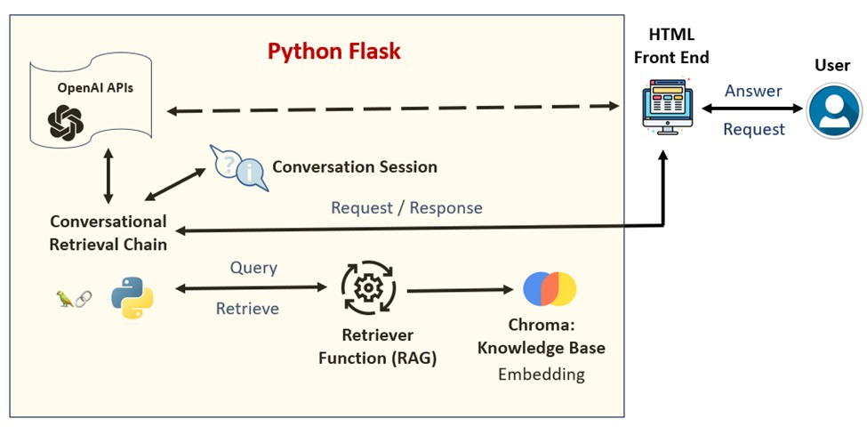
System Architecture
26-09-2024
DEPARTMENT OF INFORMATION SCIENCE AND ENGINEERING

Slide 16
Implementation

Slide 17
Implementation
1. Frontend Development
Tech: HTML, CSS, JavaScript
What it does: Builds the chatbot's user interface for web interaction.
2. Backend Development
Tech: Python, Flask
What it does: Handles user inputs and the chatbot's logic
3. Speech Recognition
Tech: Speech Recognition API
What it does: Lets users speak to the chatbot instead of typing.
DEPARTMENT OF INFORMATION SCIENCE AND ENGINEERING
26-09-2024

Slide 18
Implementation
4. Response Handling
Tech: JSON, Python Dictionary
What it does: Matches user questions to preset answers and formats them
for any user communication
5. Autocomplete
Tech: JavaScript, Flask
What it does: Suggests possible queries as users type to make interaction
faster.
DEPARTMENT OF INFORMATION SCIENCE AND ENGINEERING
26-09-2024

Slide 19
Expiremental Results

Slide 20
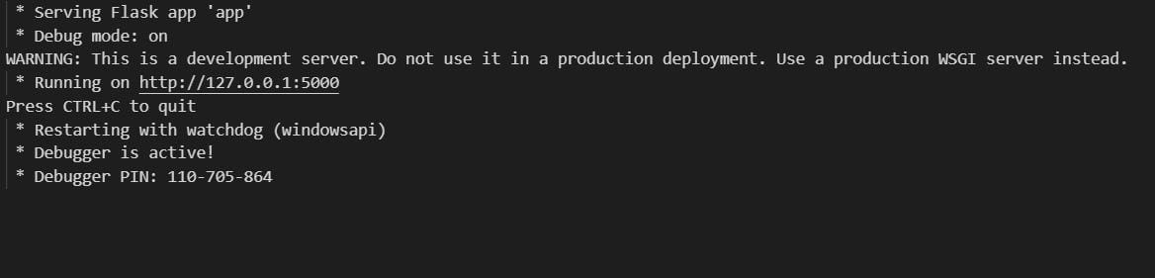
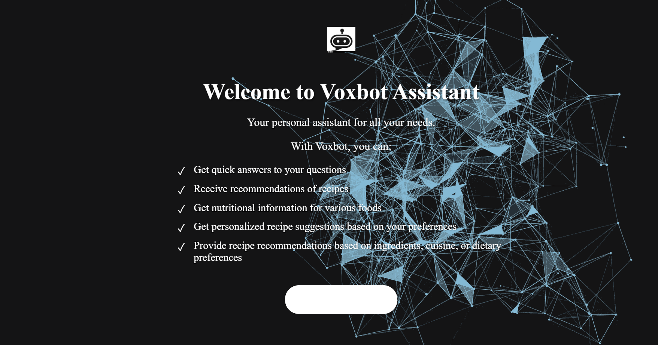
Results
Output Window
Welcome Page
DEPARTMENT OF INFORMATION SCIENCE AND ENGINEERING
26-09-2024

Slide 21
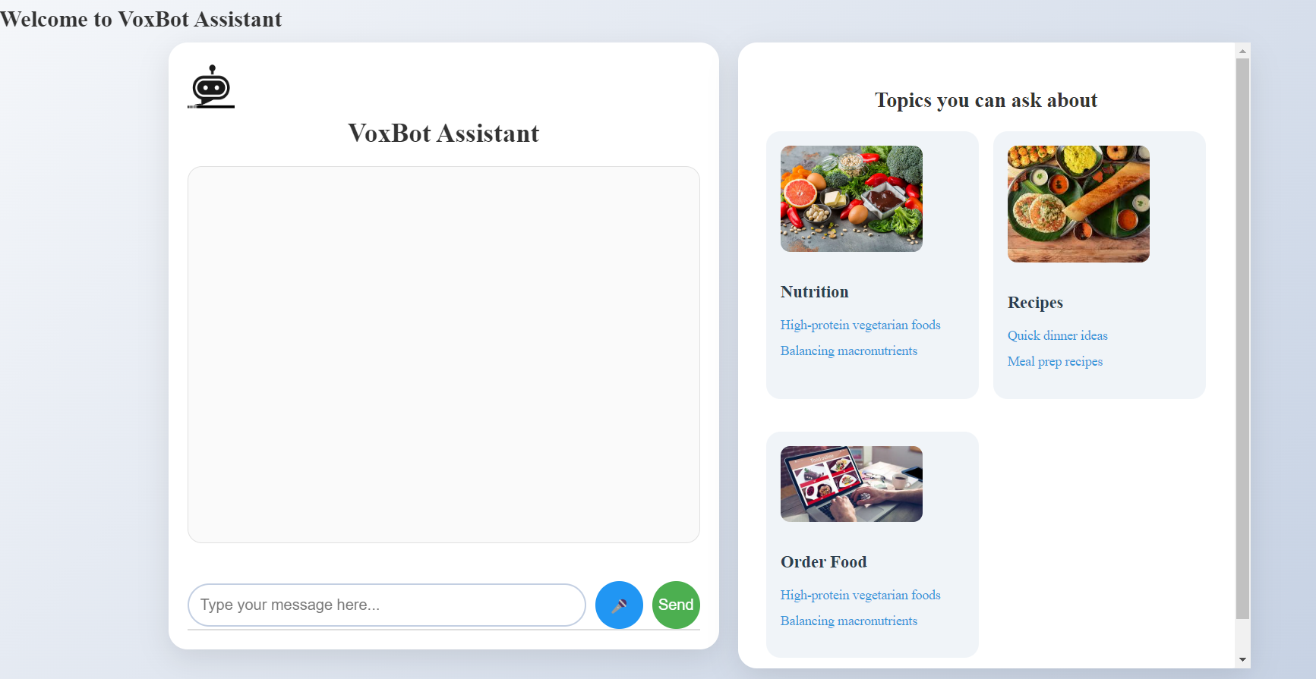
Results
Index Page
Querying the Bot
DEPARTMENT OF INFORMATION SCIENCE AND ENGINEERING
26-09-2024

Slide 22
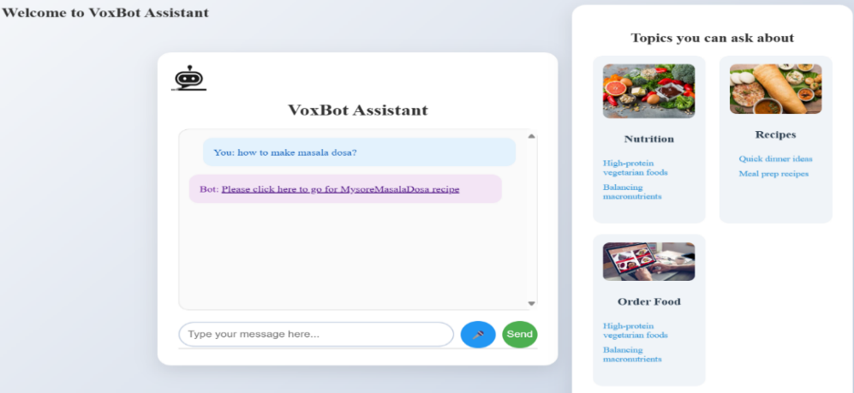
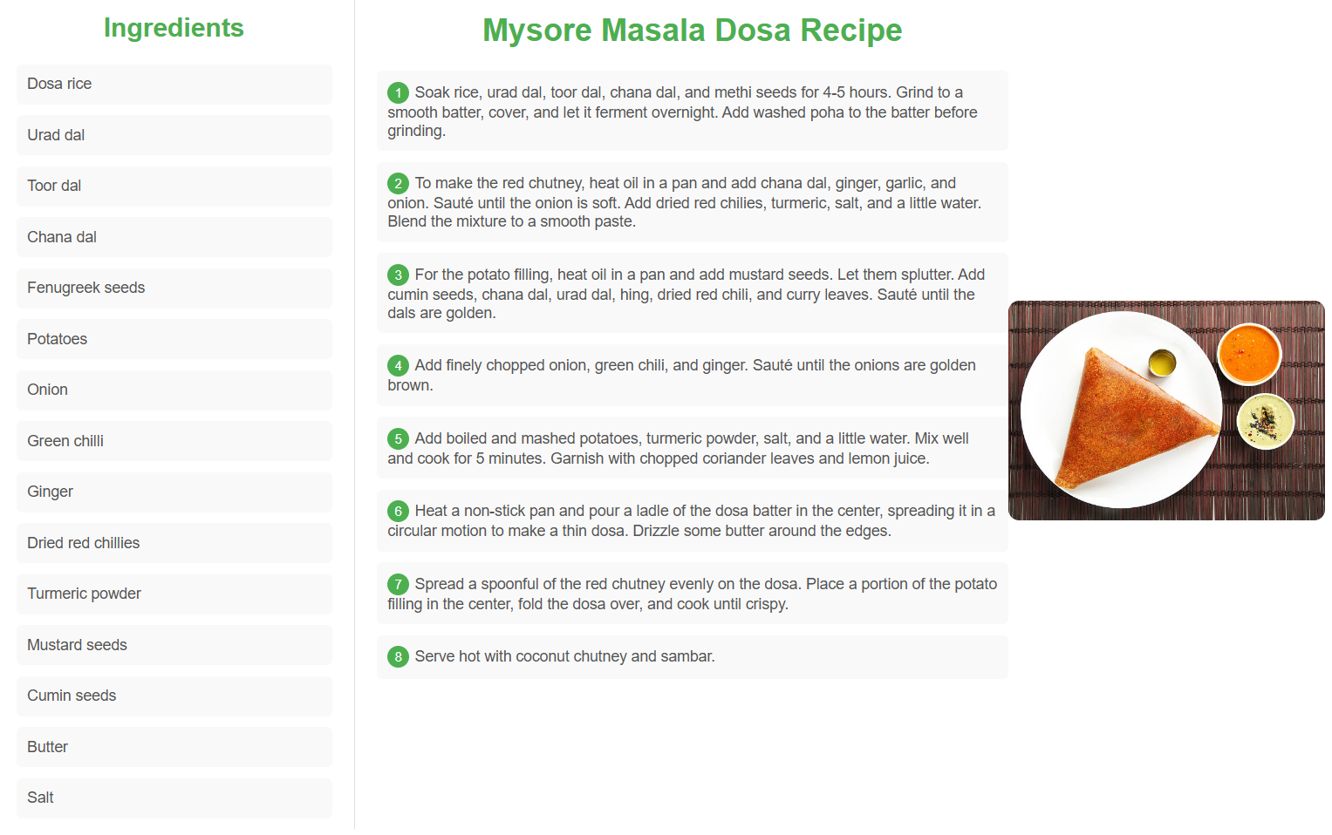
Results
Bot Output
Post Click Instructions
DEPARTMENT OF INFORMATION SCIENCE AND ENGINEERING
26-09-2024

Slide 23
Conclusion

Slide 24
Conclusion
Uses Python and Flask for the backend and HTML ,CSS, Javascript for the frontend.
Provides smooth operation on different devices and a visually appealing interface.
Allows hands-free interaction, making it easier for users to communicate.
Utilizes JSON for data exchange and a Python dictionary for quick response access.
Combines functionality and User experience, effectively handling text and voice inputs.
DEPARTMENT OF INFORMATION SCIENCE AND ENGINEERING
26-09-2024

Slide 25
References
[1] Vineet Singh etal,. “Chat Bot Using Python and Flask”,IEEE, 2024.
[2] K.Bala etal., “Chat-Bot For college Mangament System Using AI”,IRJET, vol. 04, no.11, pp.2395-0072, 2017.
[3] Vinita Kumari eta., “Medical Chat Bot using AI &NLP”,i-managers’s General for
Software Engineering, 2022.
26-09-2024
DEPARTMENT OF INFORMATION SCIENCE AND ENGINEERING

Slide 26
Thank you

